Slide 1
Scholarly and Academic Practice http://staffweb.cms.gre.ac.uk/~mk05/
Dr Kevin McManus
2015
University of Greenwich

Slide 2
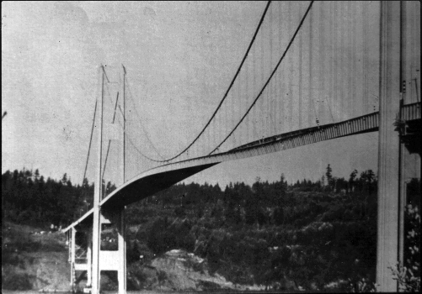
"Image-Tacoma Narrows Bridge1" Licensed under Fair use via Wikipedia
https://en.wikipedia.org/wiki/File:Image-Tacoma_Narrows_Bridge1.gif#/media/File:Image-Tacoma_Narrows_Bridge1.gif
2015
University of Greenwich

Slide 3

2015
University of Greenwich

Slide 4
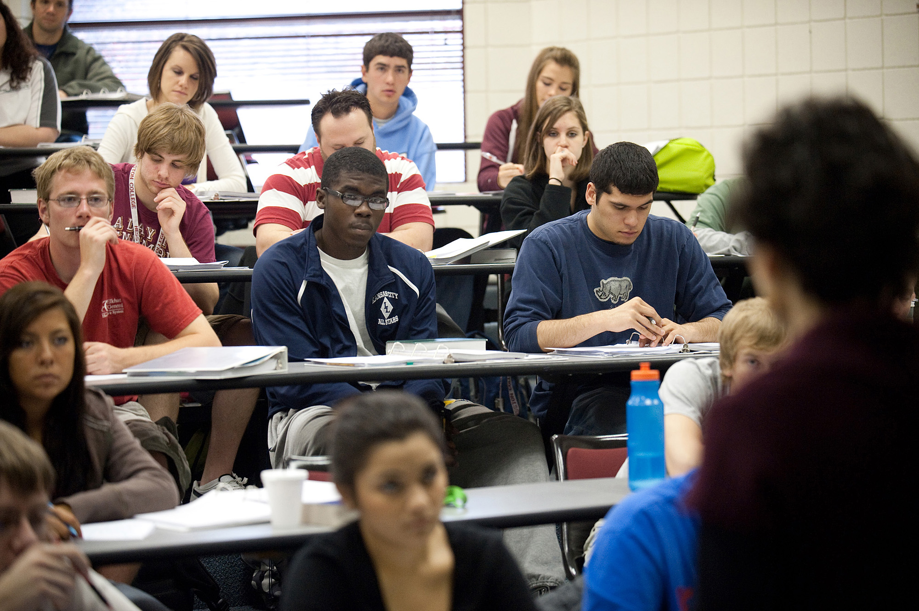
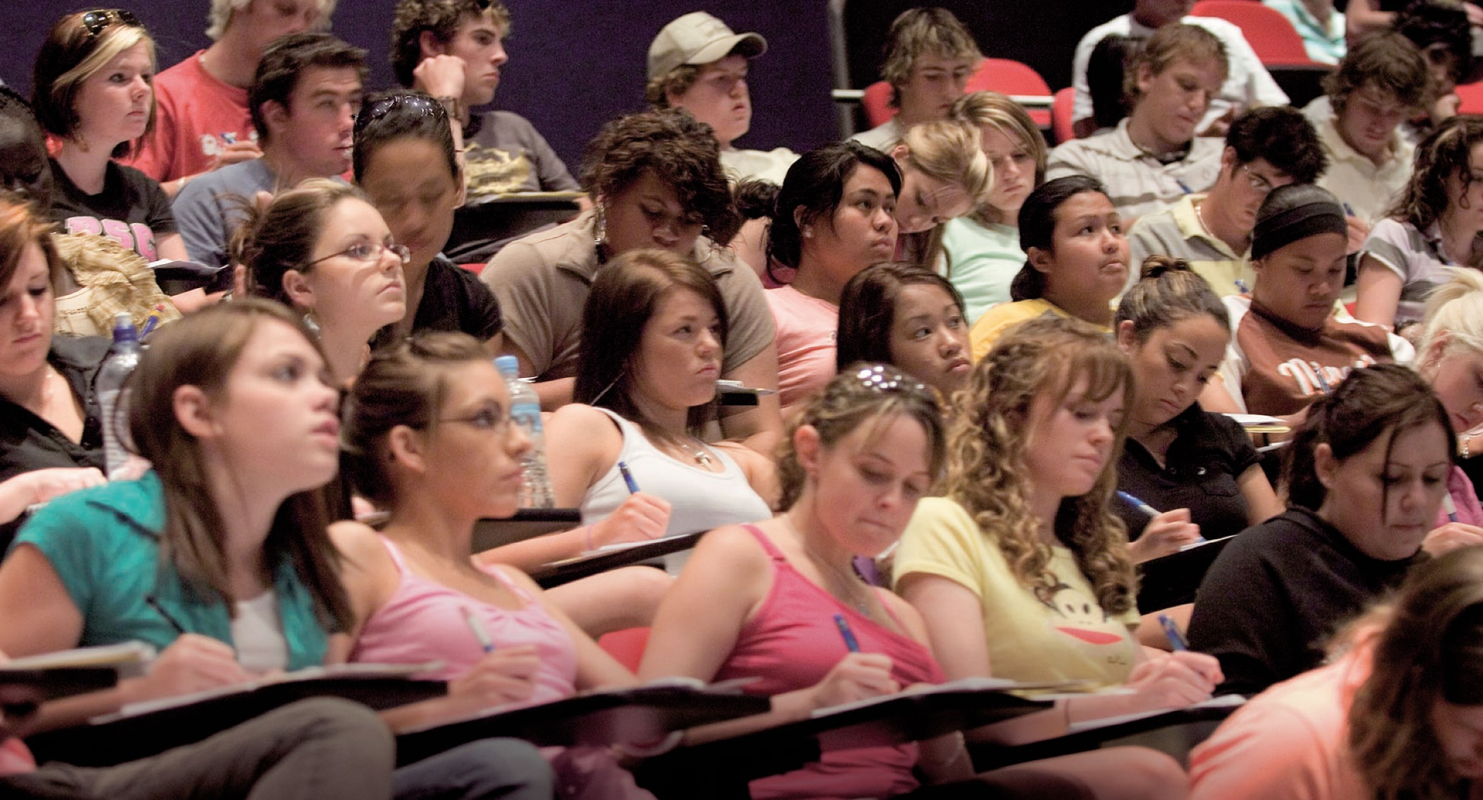
Image © Monash University, Melbourne, Victoria.
Image © Hesston College, Hesston, Kansas
2015
University of Greenwich

Slide 5
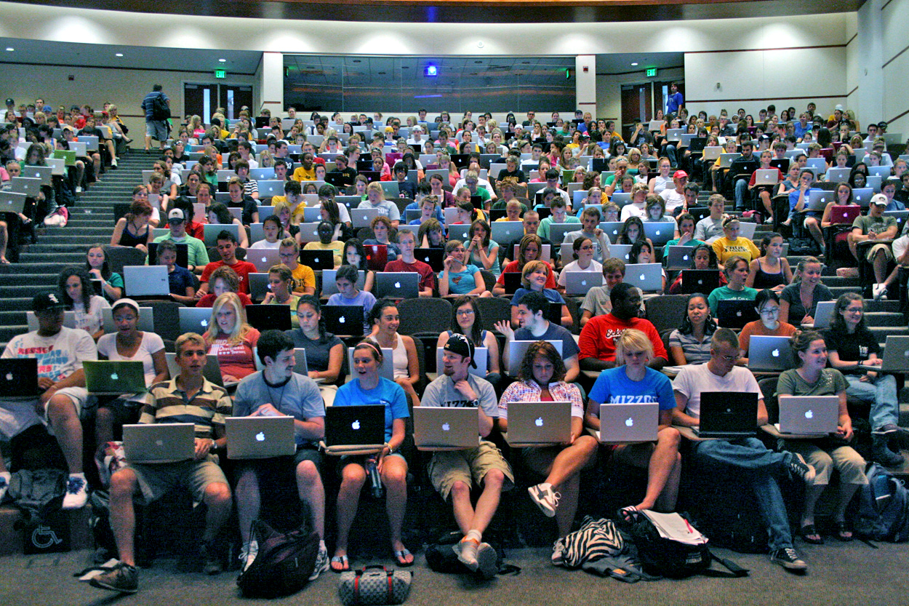
Image © University of California, Davis, California
2015
University of Greenwich

Slide 6
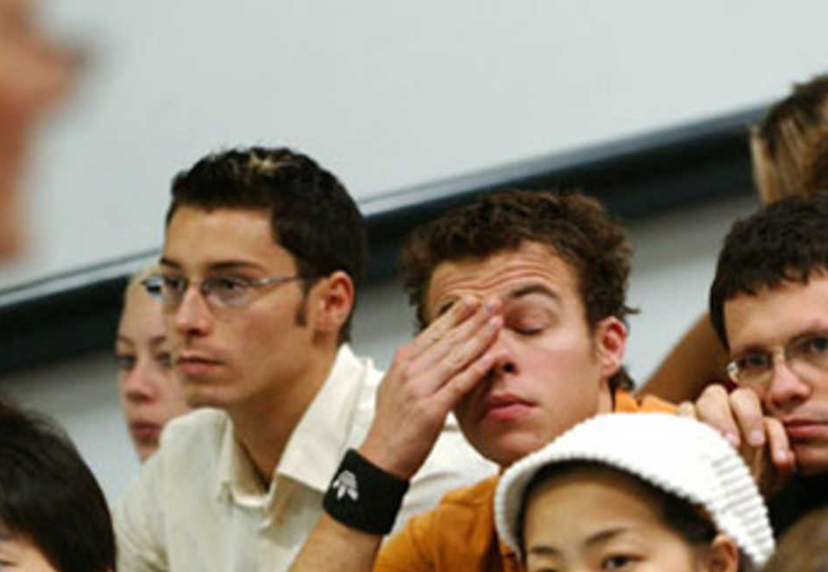
2015
University of Greenwich

Slide 7
What happens next?
As well as this lecture you have 2 hours of tutorial each week
  check your TT tomorrow morning
There will be classroom activities and homework
  you get marks for completing the homework
  these marks are multiplied by your attendance
2015
University of Greenwich

Slide 8

Questions?
2015
University of Greenwich

Slide 9
If it ain't fun you probably aren't doing it right
2015
University of Greenwich

